Slide 1
Chandigarh Laser Clinic
Dr Rohit Bansal, a specialist in a skin, Hair (MBBS, DDV), We provide the best treatment of your skin related issues and hair loss problem also. Dr Bansal is the famous skin & hair specialist doctor in the tricity (Chandigarh, Panchkula, Manimajra, Mohali), Chandigarh laser clinic has the best dermatologist specialist doctors to provide skin & hair problem solution, Nowadays face everybody skin & hair problems like- Acne, Anti Ageing, Anti pigmentation, Hair loss, Hair removal, Burn skin marks etc. We feel proud that we offering this unique treatment as affordable prices without any pain or side effect.

Slide 2
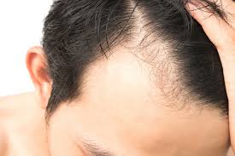
Hair Loss Treatment in Chandigarh
Dr. Bansal Clinic is a series of skin care and hair loss treatment in Chandigarh across Cities . We are known for its quality treatment. We provide the right professional advice for patients with many years of experience. We are known as a safe alternative or extra treatment for inferior level laser treatment for hair loss.

Slide 3
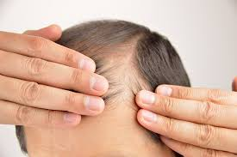
Best Hair Loss Treatment in Chandigarh
Nowadays men and women are very common in lose hair. But don’t worry about the your continuously best hair loss treatment in Chandigarh. We have all the solutions to treat the quality of hair fall. We believe in giving sufficient time to each patient so that patients understand their disease and treatment properly.

Slide 4
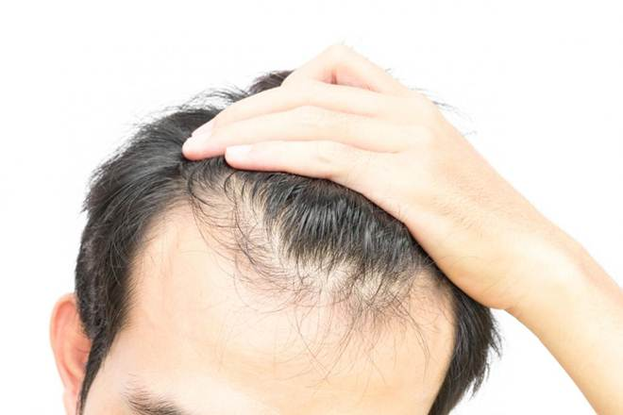
Hair Treatment in PGI Chandigarh
We are one of the most cost effective places for hair treatment of PGI in Chandigarh. We are the right place for you. We help you to treat all your hair loss problems. Here all the procedures are done after a detailed diagnosis of the patient's skull condition. We guarantee the results of all the hair loss problems using the latest techniques.

Slide 5
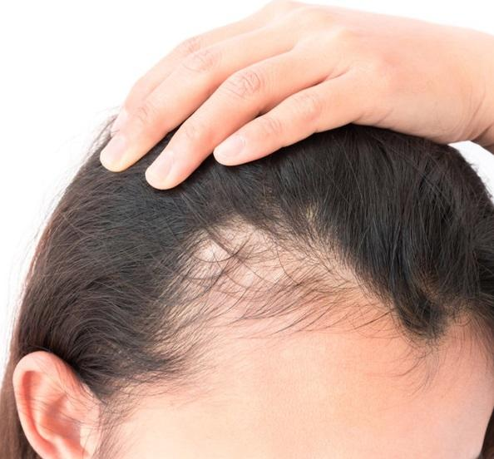
Hair transplant in Chandigarh
Dr. Bansal Offers is the Best hair transplant in Chandigarh. We are Provide surgical & non-surgical treatments on bald scalp, hair transplants hair removal etc . Our Expert team is transplanting bald site from a fertile portion of the hair follicle of individual hair, in the hair transplantation process.

Slide 6
OFFICE ADDRESS

